Slide 1

Flask RESTful API: Understanding GET, POST, PUT, and DELETE

Slide 2
What is a RESTful API?
Definition
Why Use It?
RESTful APIs leverage HTTP requests to perform CRUD operations (Create, Read, Update, Delete) on resources.
RESTful APIs offer a standardized and lightweight way for clients and servers to communicate, promoting scalability.

Slide 3
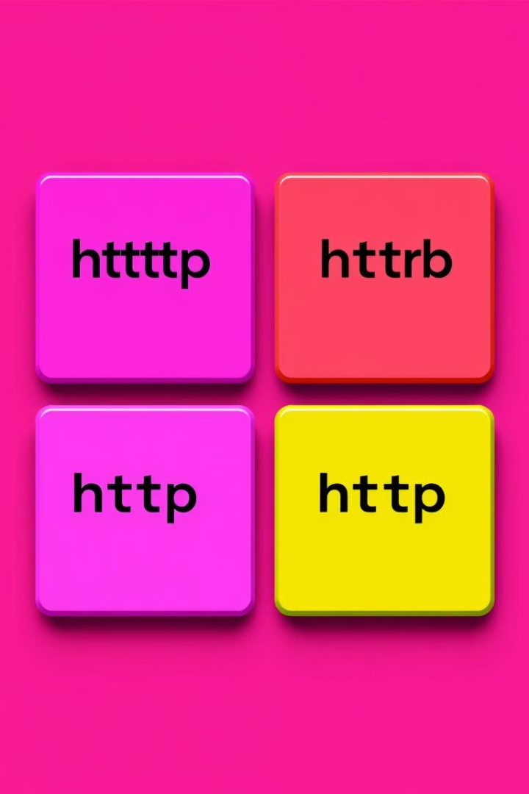
HTTP Methods Overview
1
GET
2
POST
Retrieves data from the server.
Sends data to the server to create a new resource.
3
PUT
4
DELETE
Updates an existing resource.
Removes a resource from the server.

Slide 4
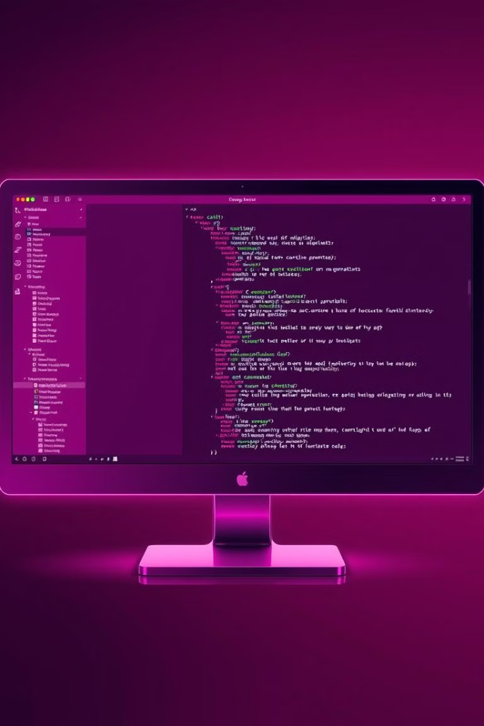
Flask Setup
Installation
Create app.py
Start by installing Flask: pip install flask
Create a new file named app.py. This will be your Flask application.
Define Routes
In app.py, define routes for each HTTP method you need to implement.

Slide 5
GET Request
Purpose
Code Example
The GET method fetches data from the server.
@app.route('/items', methods=['GET']) def get_items(): return jsonify(data), 200

Slide 6
POST Request
Purpose
Code Example
The POST method adds new data to the server.
@app.route('/items', methods=['POST']) def create_item(): new_item = request.json data.append(new_item) return jsonify(new_item), 201

Slide 7
PUT Request
Purpose
Code Example
The PUT method updates existing data on the server.
@app.route('/items/', methods=['PUT']) def update_item(item_id): updates = request.json item.update(updates) return jsonify(item), 200

Slide 8
DELETE Request
Purpose
Code Example
The DELETE method removes data from the server.
@app.route('/items/', methods=['DELETE']) def delete_item(item_id): global data data = [item for item in data if item["id"] != item_id] return jsonify({"message": "Item deleted"}), 200

Slide 9



Key Takeaways
CRUD Operations
Flask Efficiency
RESTful APIs enable CRUD operations using HTTP methods: GET, POST, PUT, and DELETE.
Flask simplifies API building, making it easy to create and manage RESTful services.

Slide 10



Next Steps: Putting It Into Practice
Start Building
1
Use this knowledge to create your own Flask RESTful API, applying GET, POST, PUT, and DELETE methods.
Explore
2
Learn about error handling, authentication, and authorization to make your API more robust and secure.
Experiment
3
Try integrating your Flask API with different clients and applications to understand its real-world use cases.

